Slide 1
Elsie Schlafmann
March 10, 1912 – March 10, 2014

Slide 2
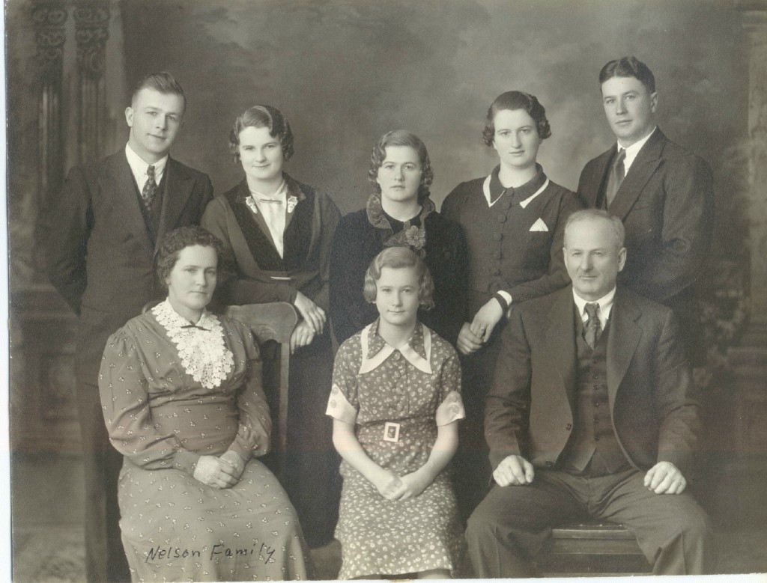

Slide 3
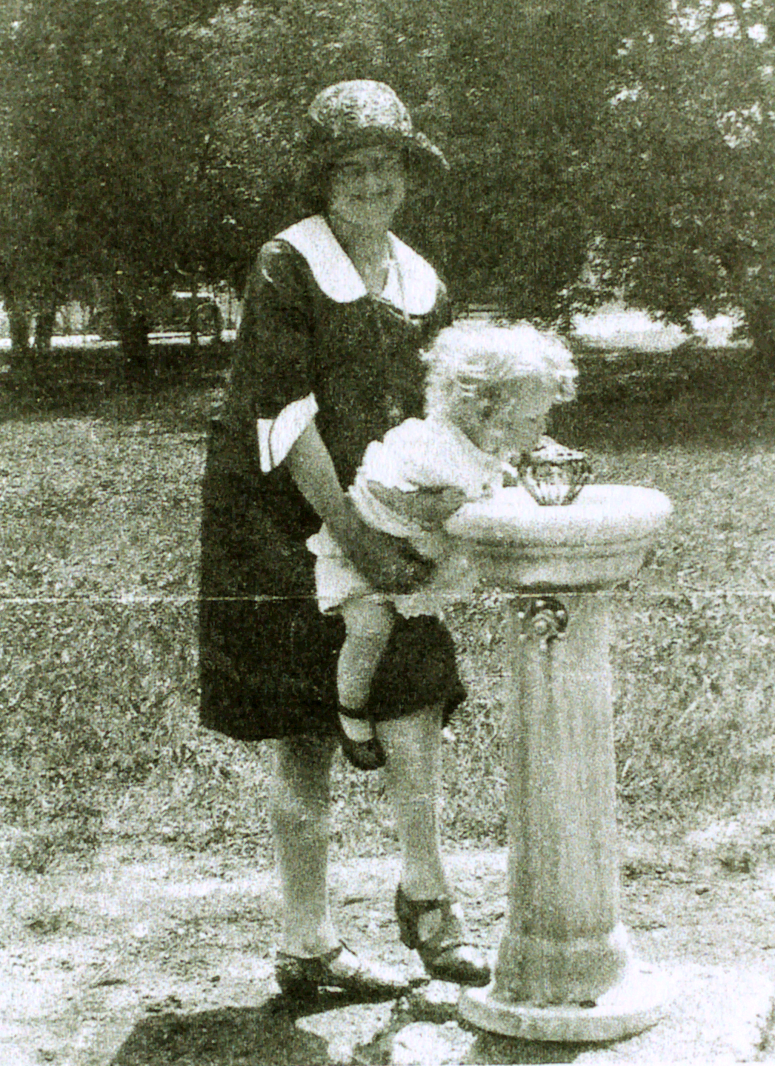
Aunt Elsie helping Joy Belle

Slide 4
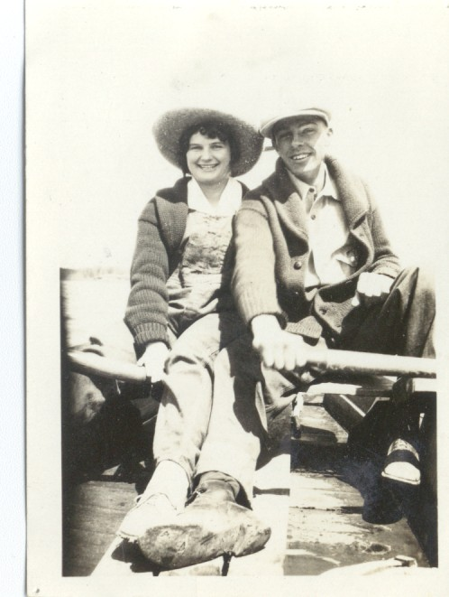

Slide 5
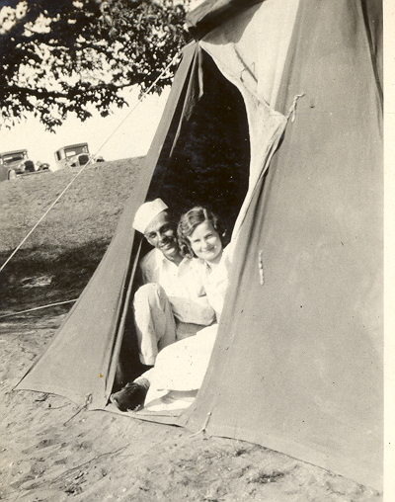

Slide 6
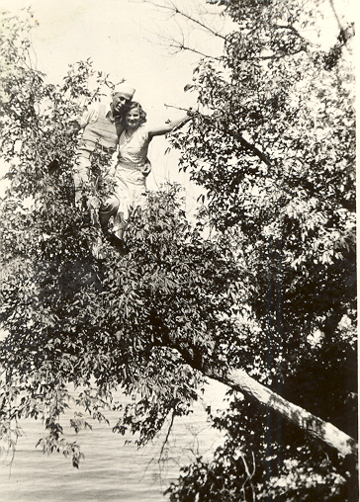

Slide 7
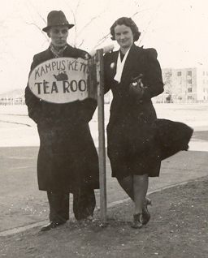

Slide 8
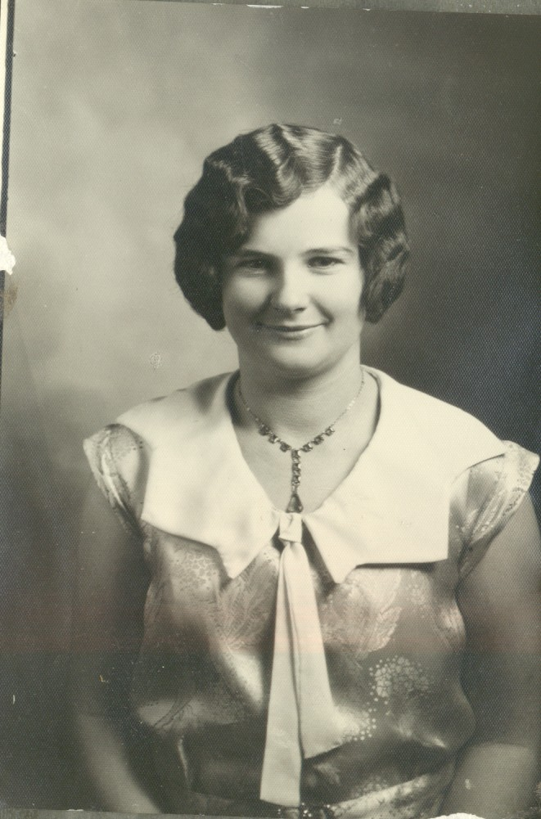

Slide 9
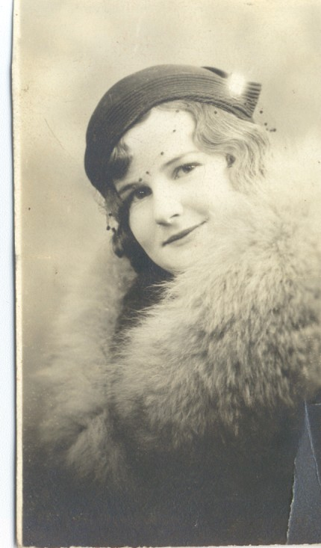

Slide 10
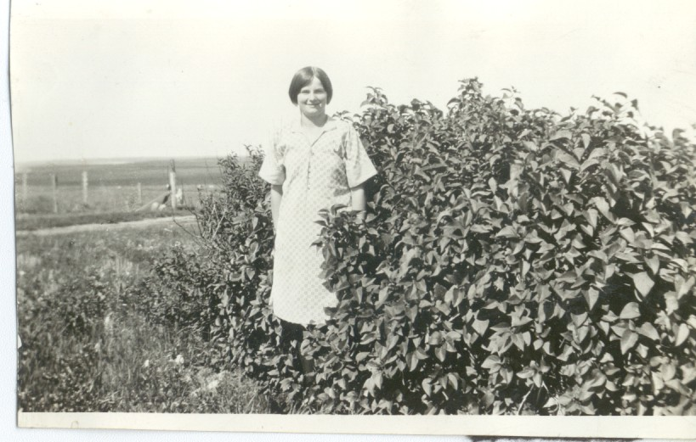

Slide 11
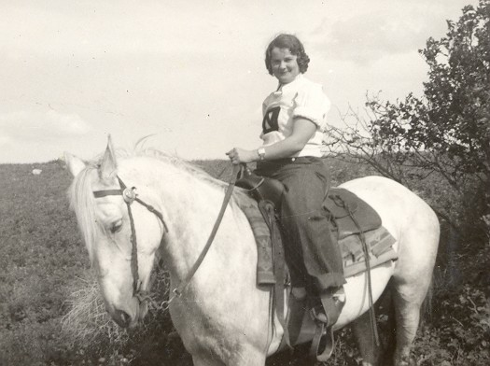

Slide 12
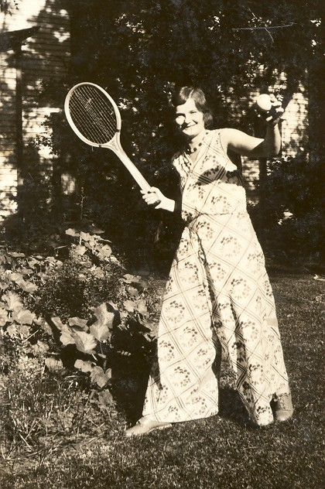

Slide 13
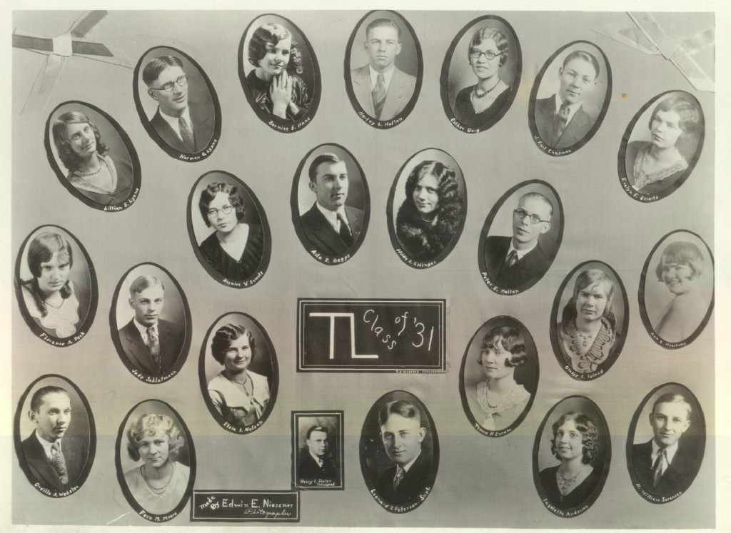
Turtle Lake Class of ‘31

Slide 14
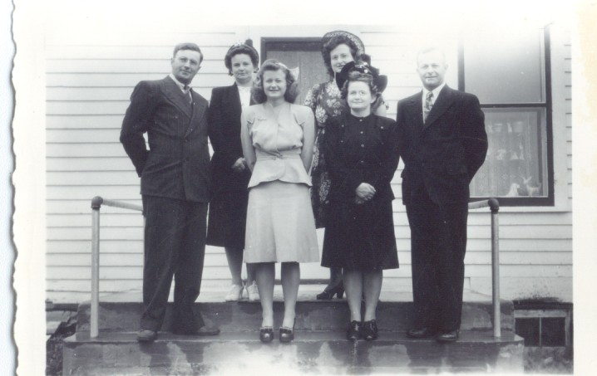

Slide 15
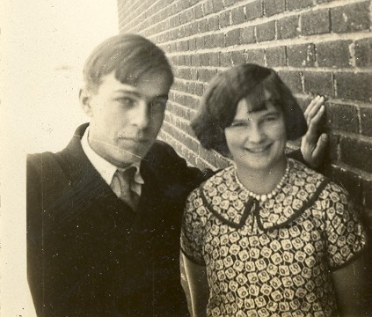

Slide 16
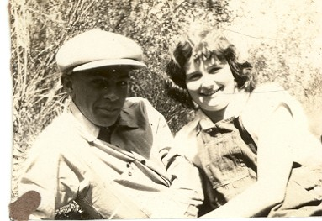

Slide 17
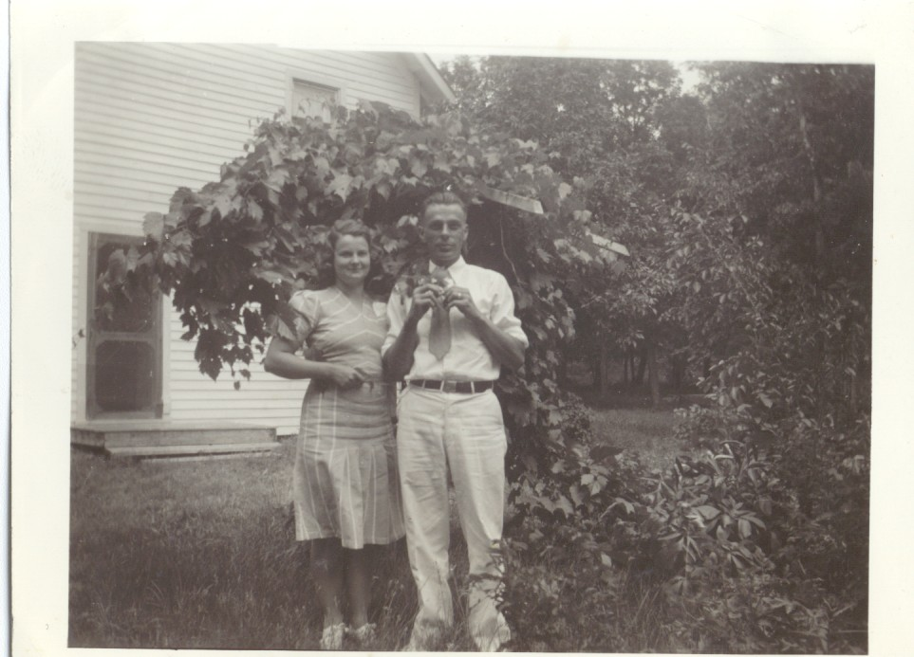

Slide 18
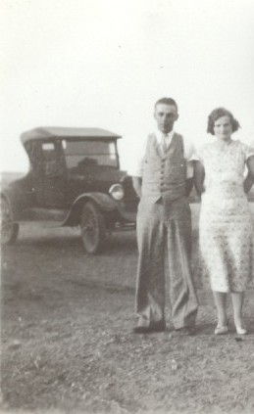

Slide 19
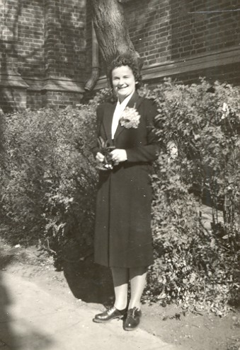

Slide 20
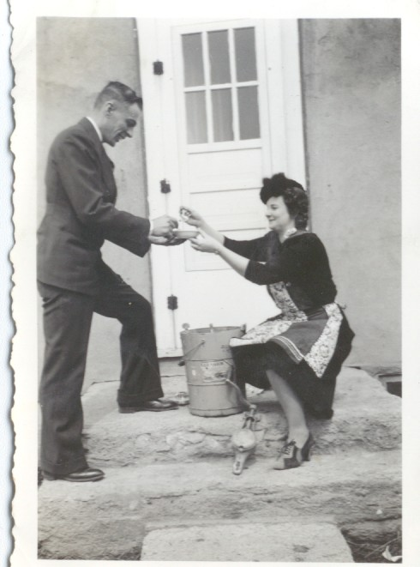
Making Ice Cream

Slide 21
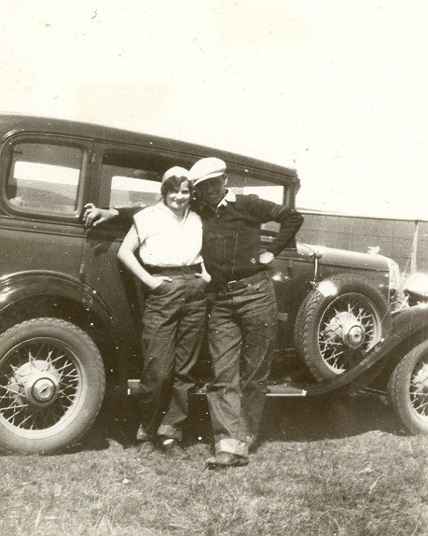

Slide 22
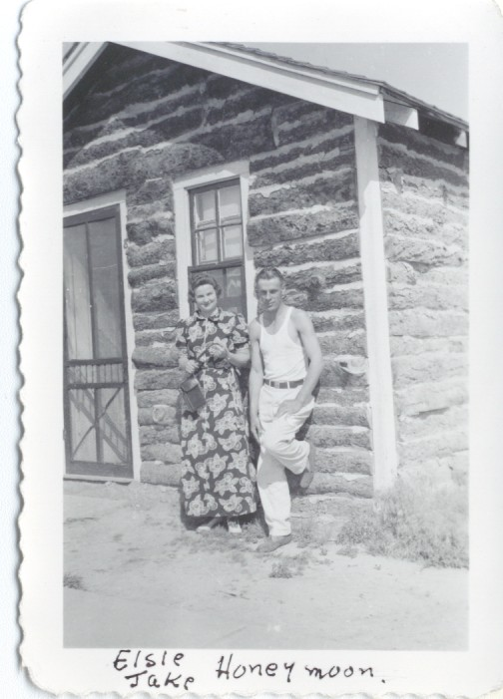
Jake &
Elsie on their Honeymoon

Slide 23
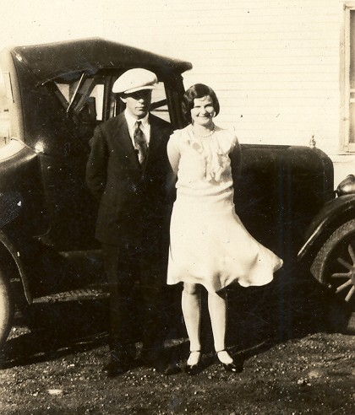

Slide 24
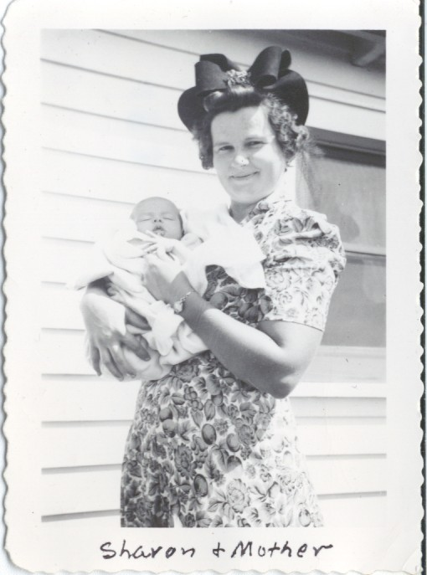

Slide 25
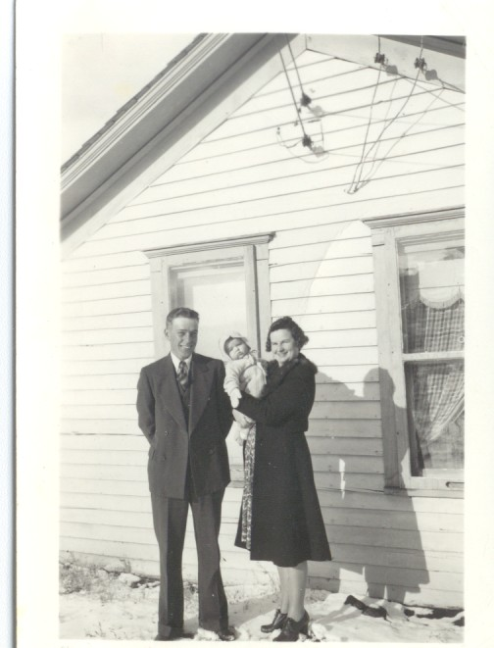

Slide 26
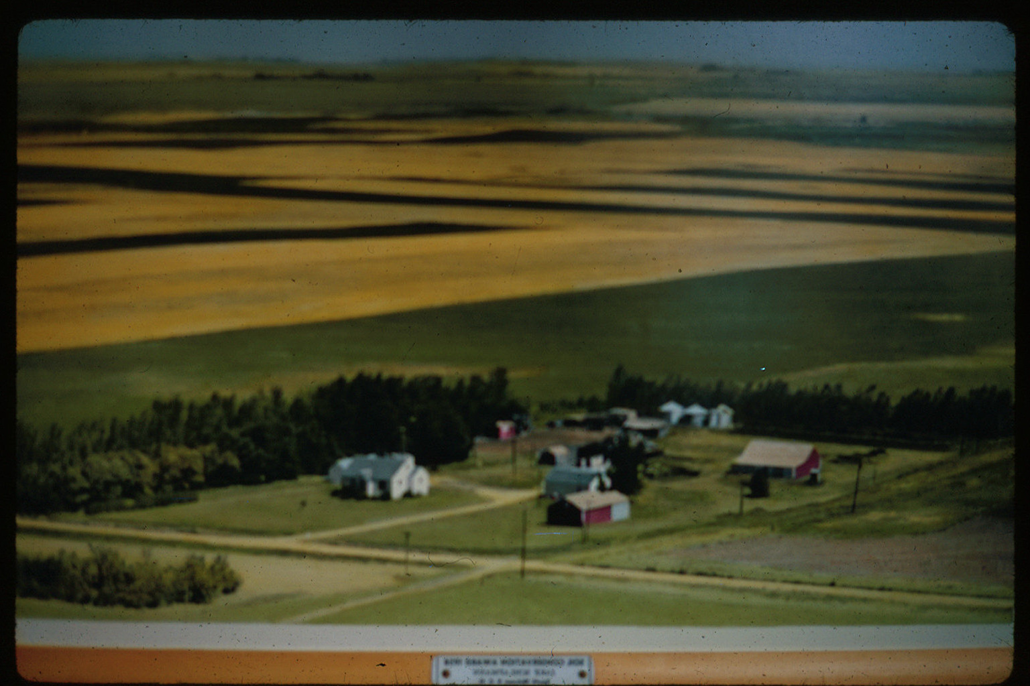
The Farm

Slide 27
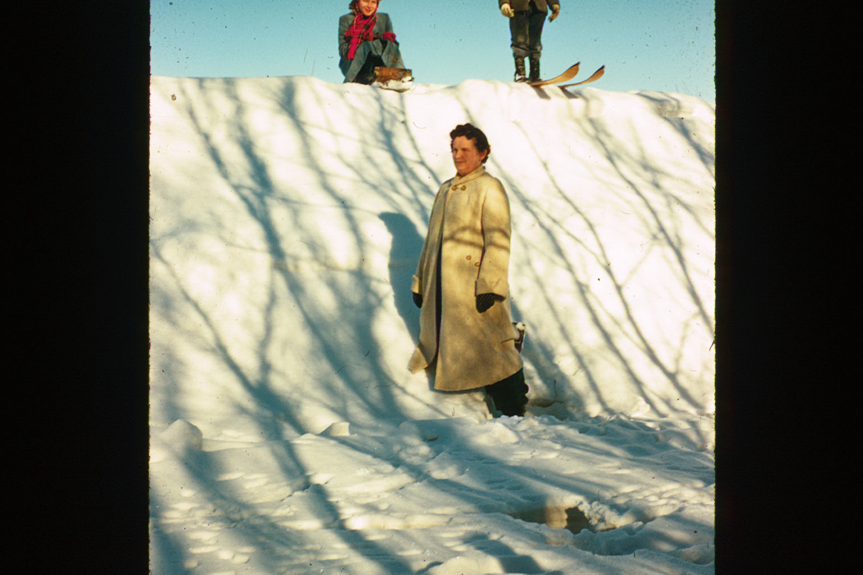

Slide 28
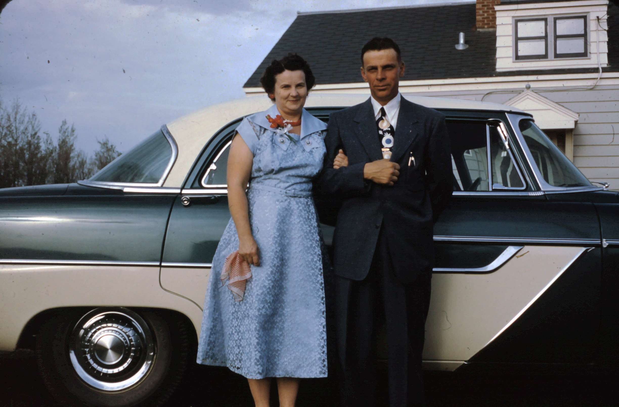

Slide 29
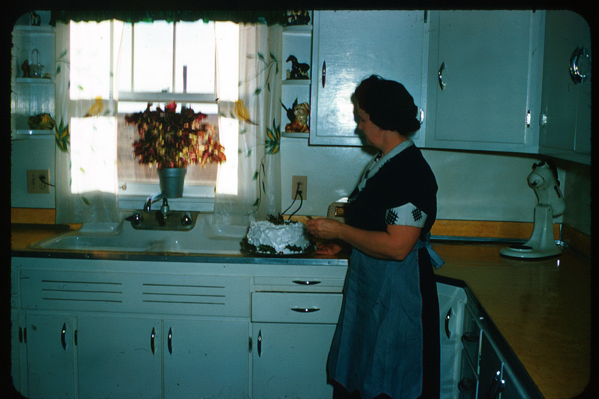

Slide 30
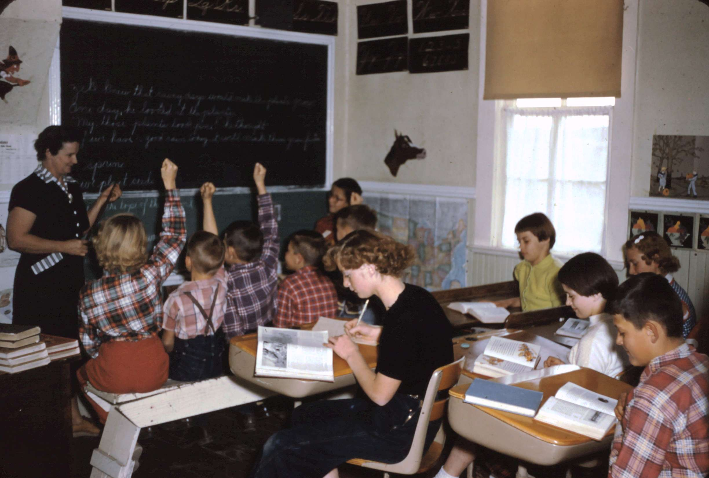
Elsie teaching at the Koenig School - 1954

Slide 31
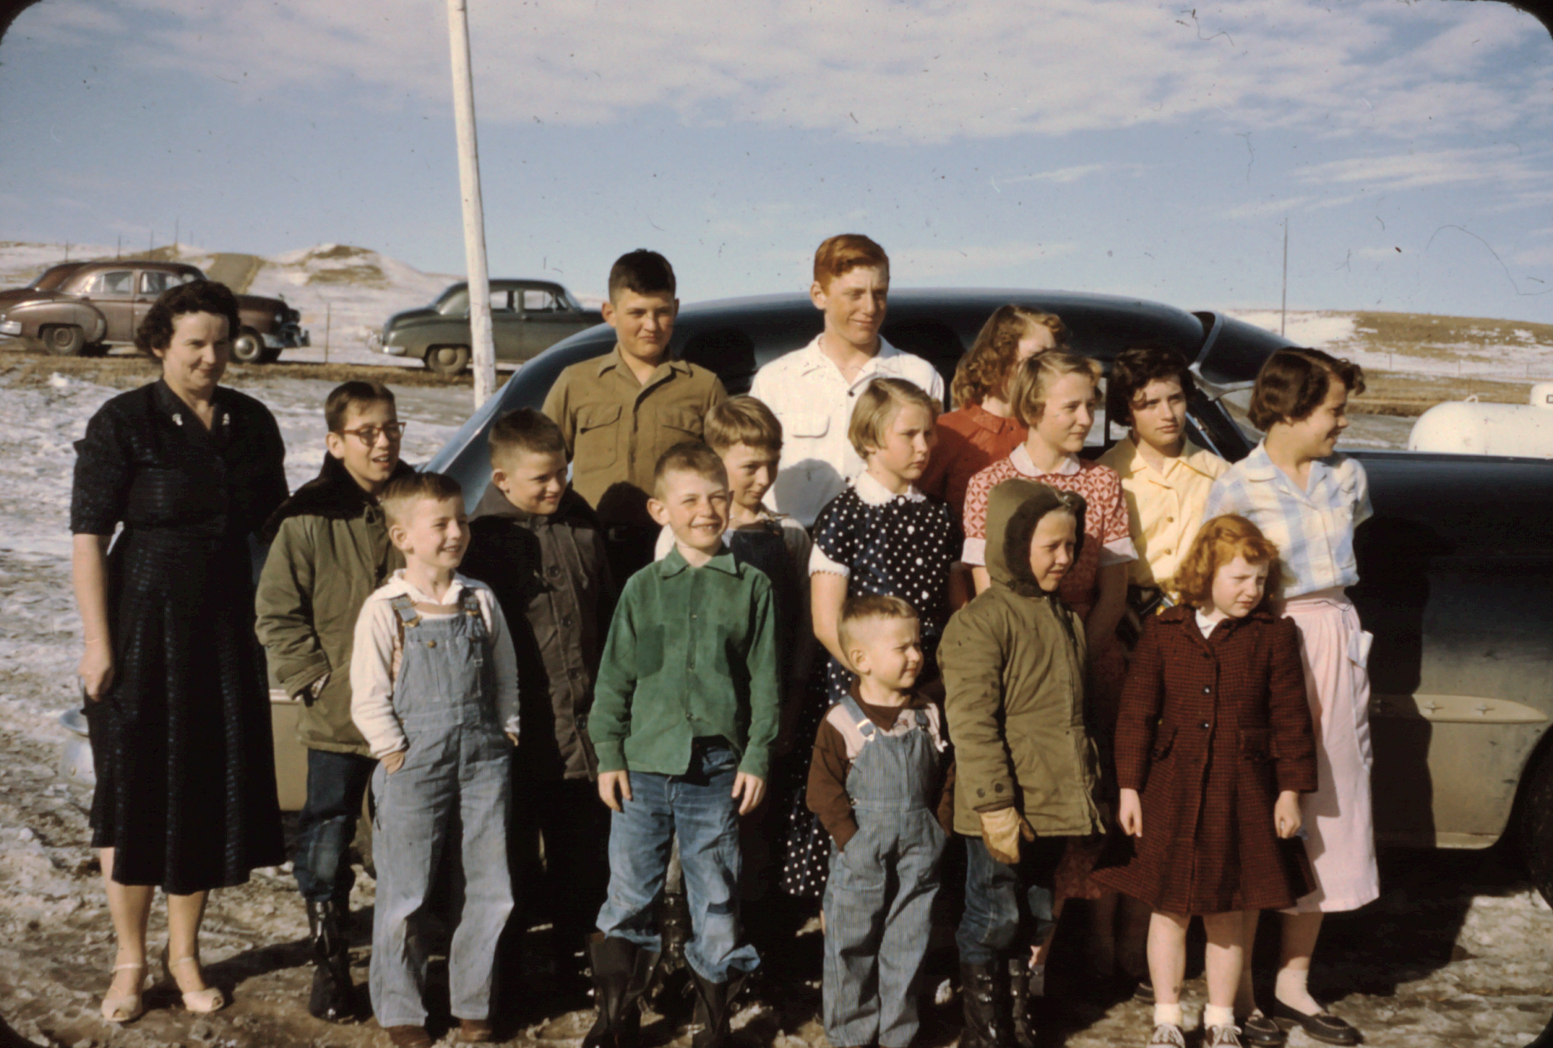
Koenig School Students

Slide 32
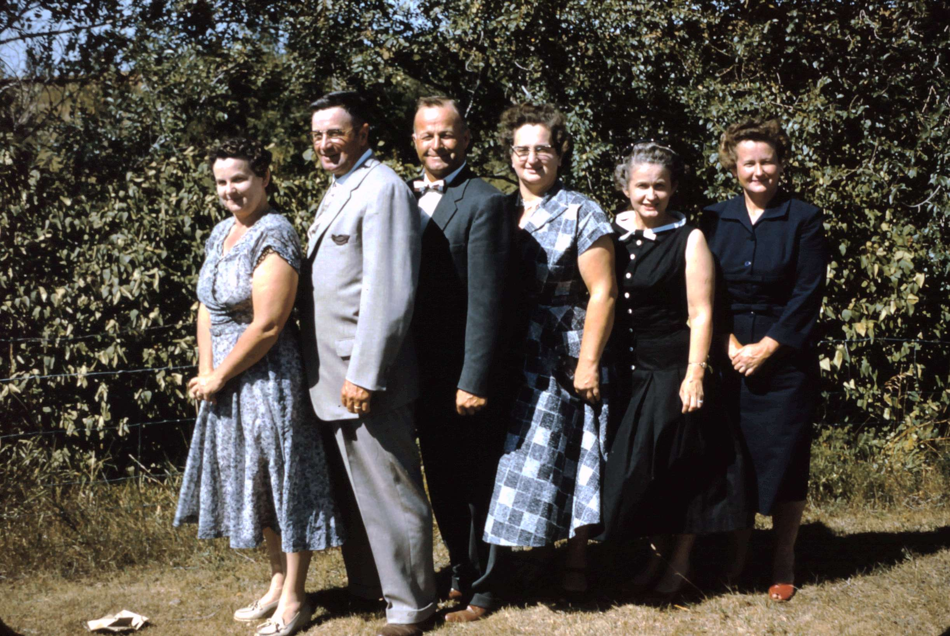
Nelson children - 1957

Slide 33
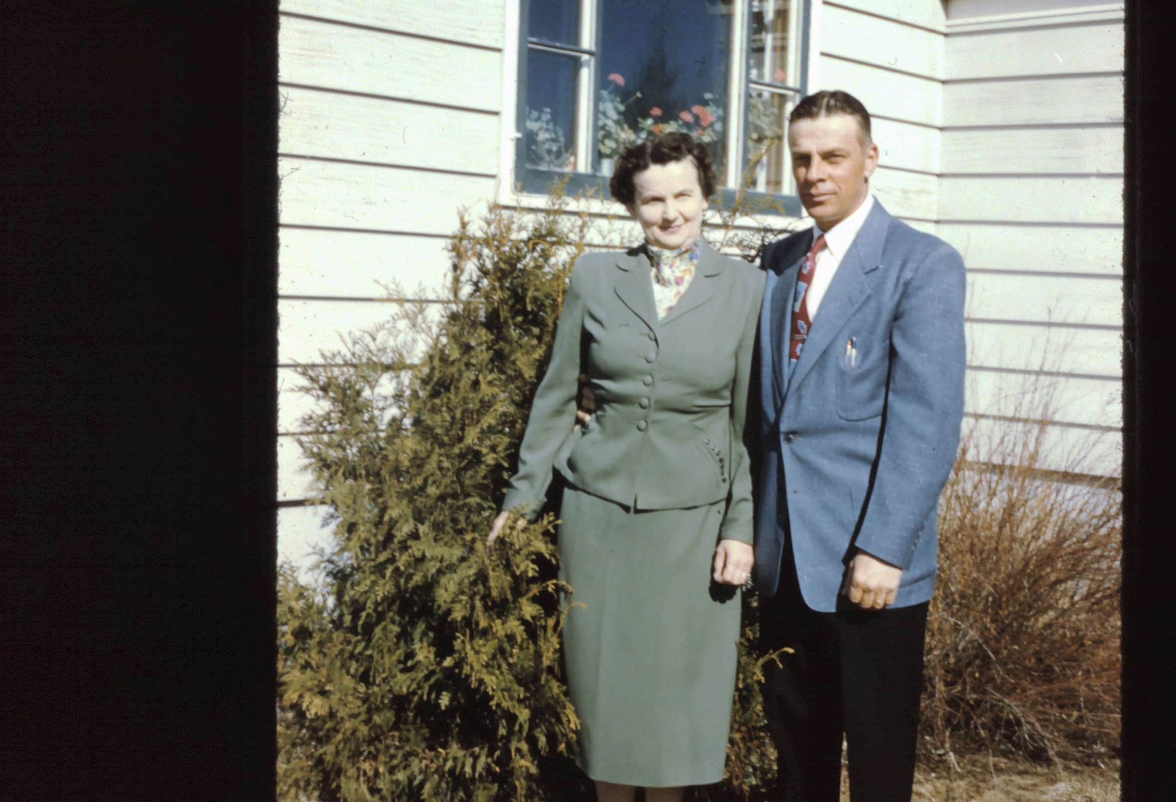

Slide 34
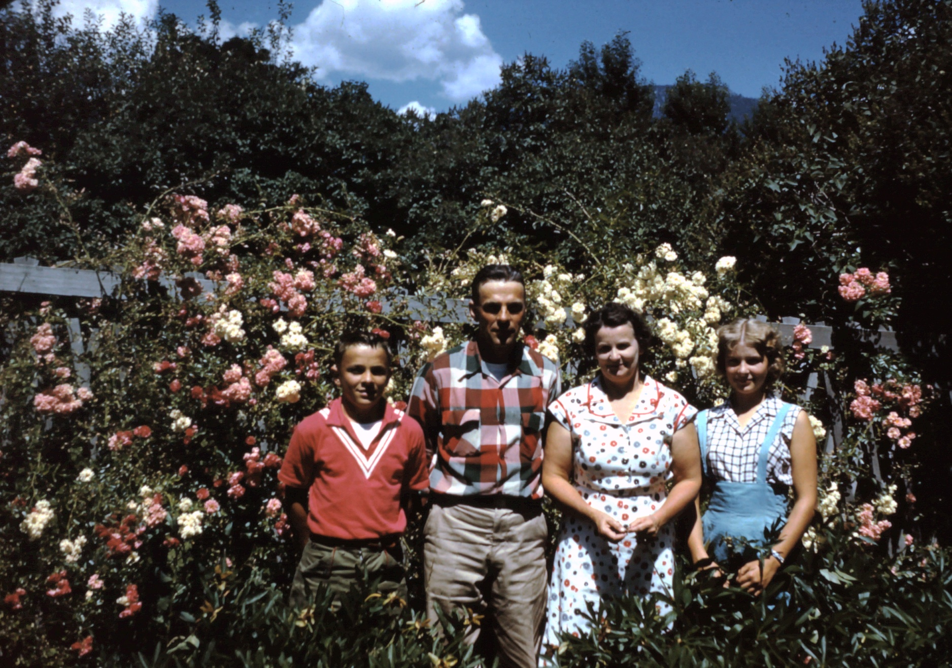
The Schlafmann Family at Thompson Falls

Slide 35
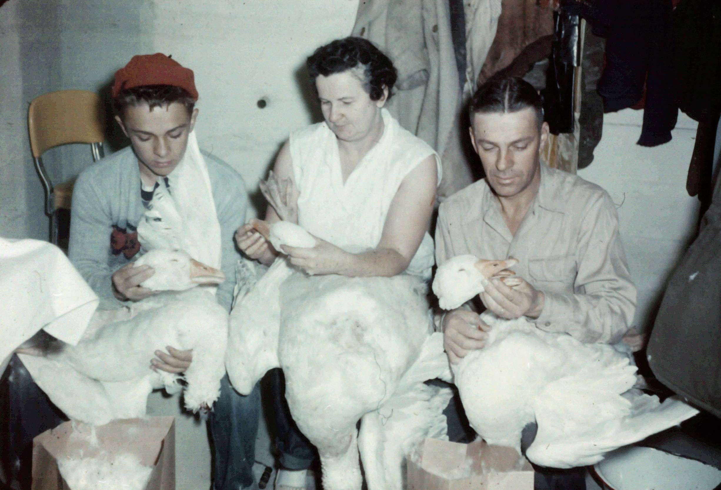
Quality family time cleaning geese

Slide 36
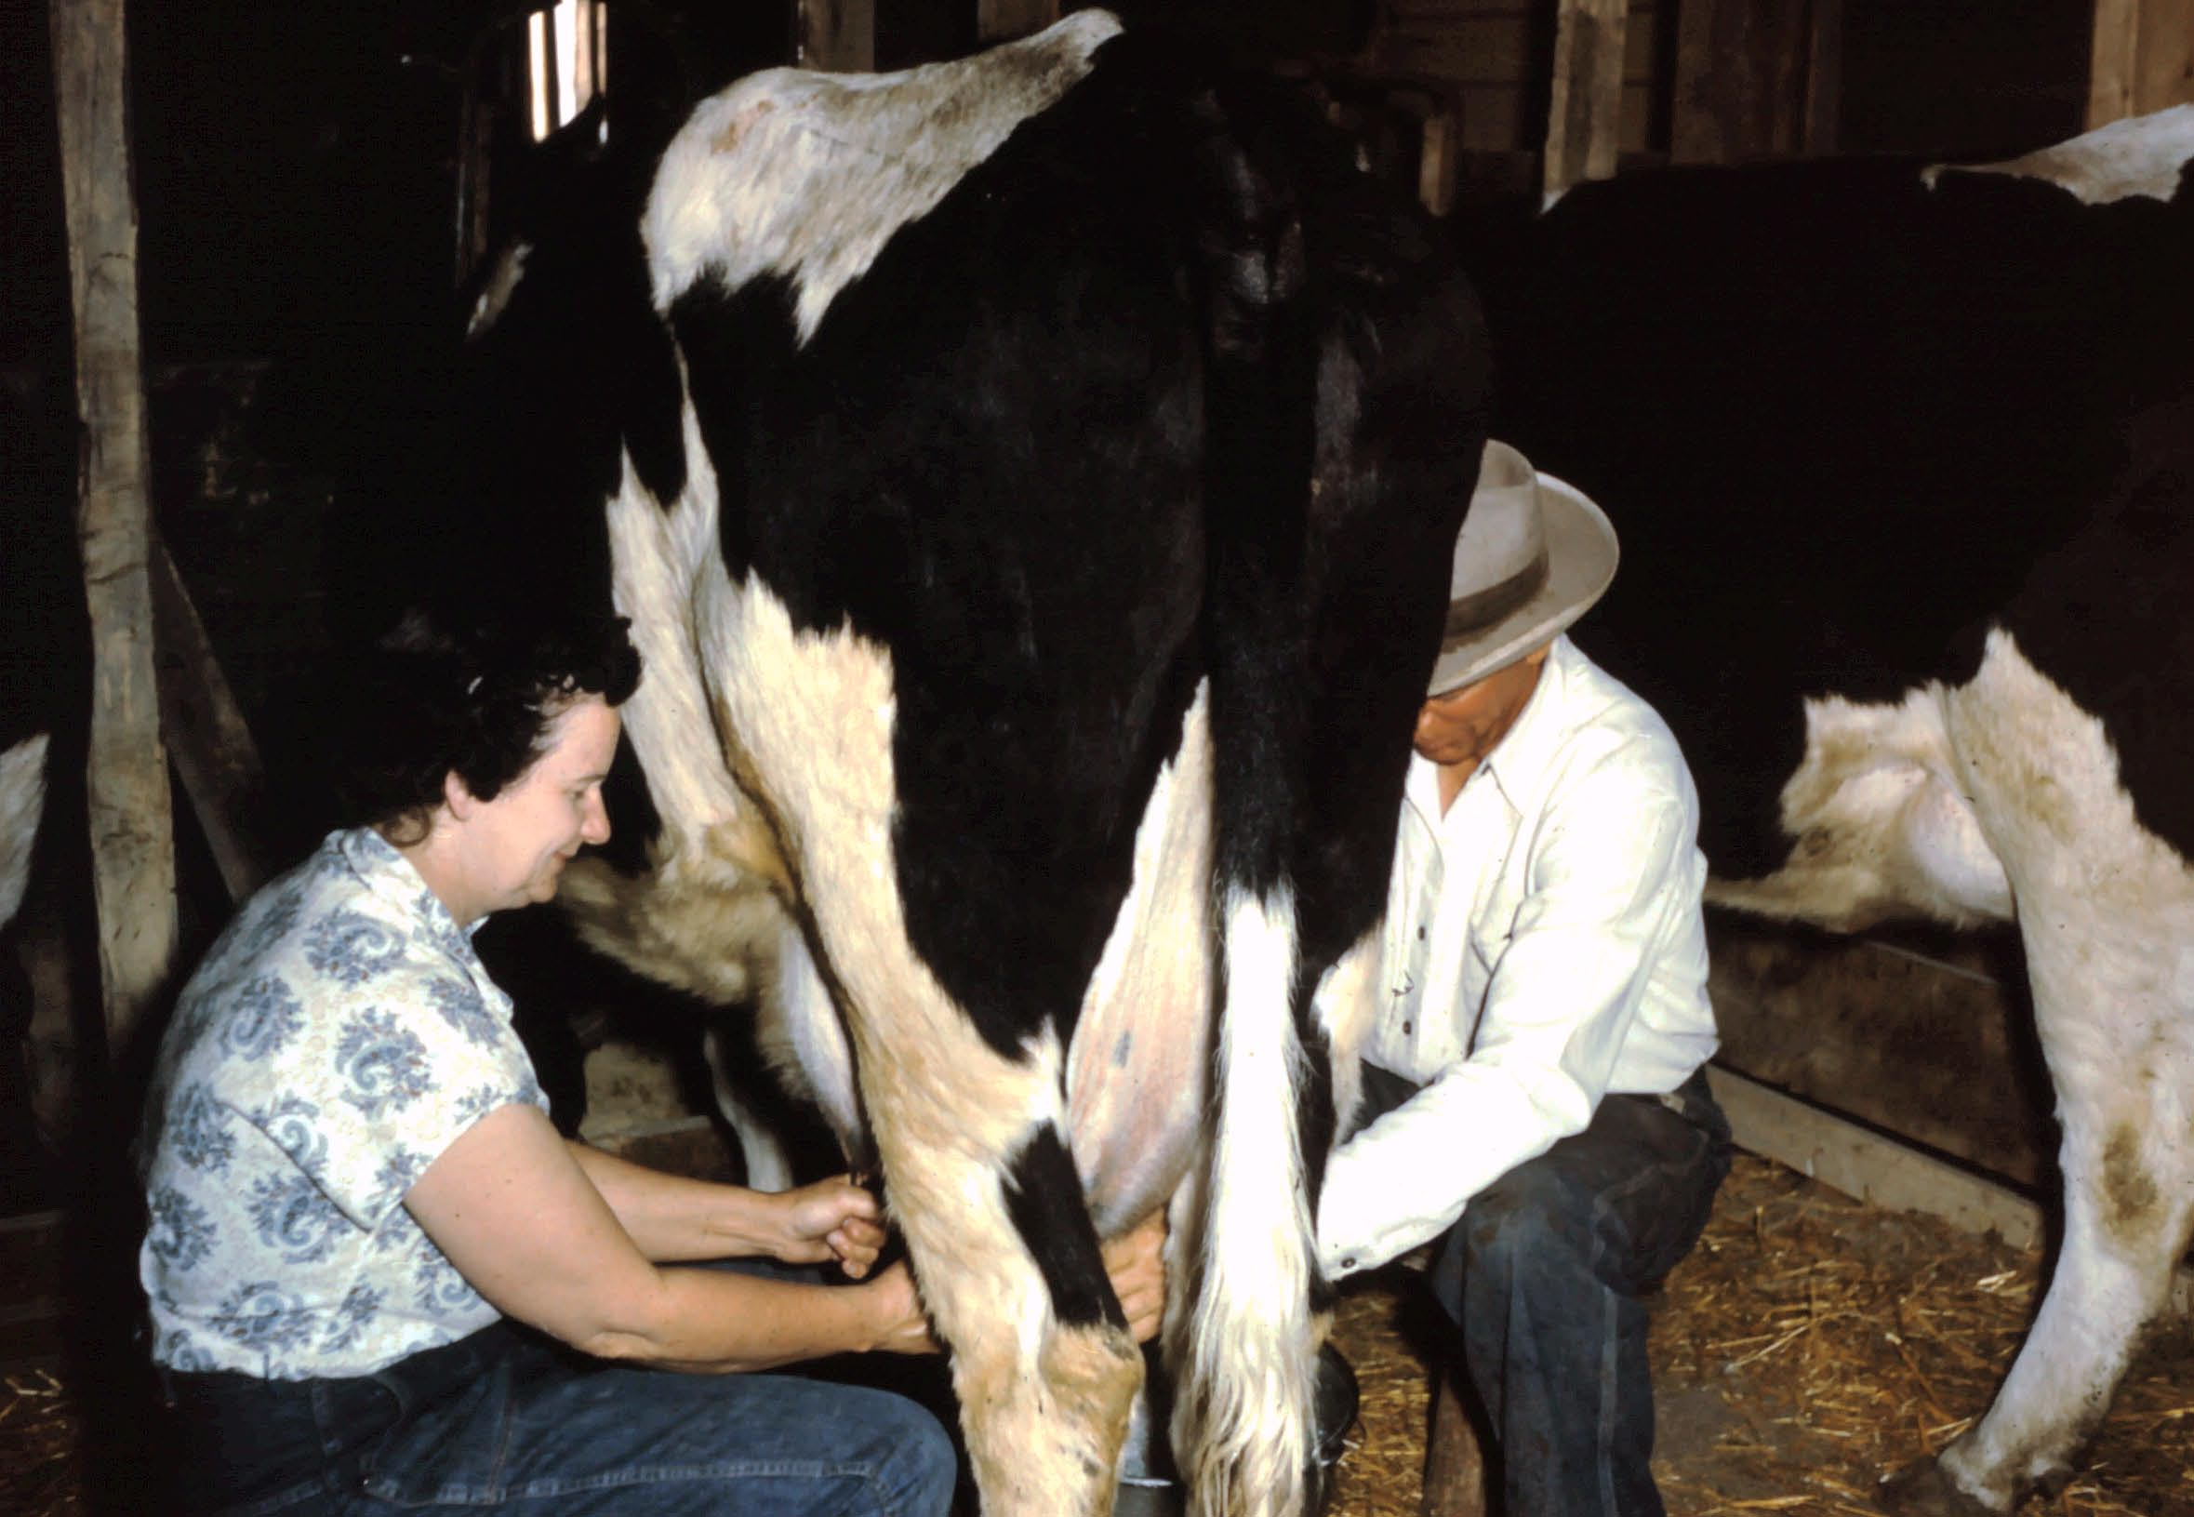
Jake & Elsie milking the cow

Slide 37
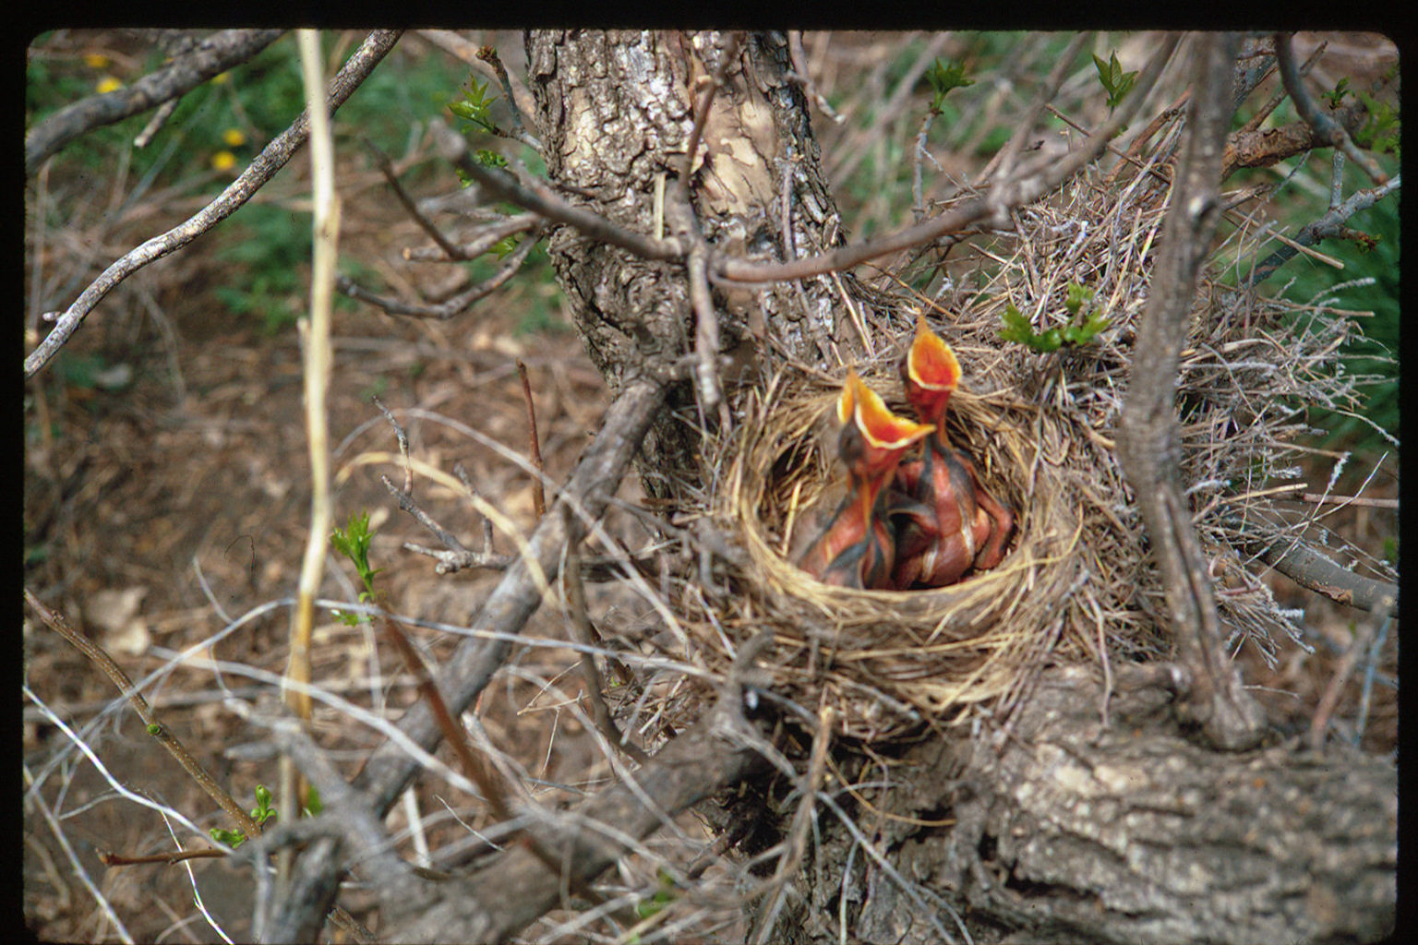
Elsie always loved birds

Slide 38
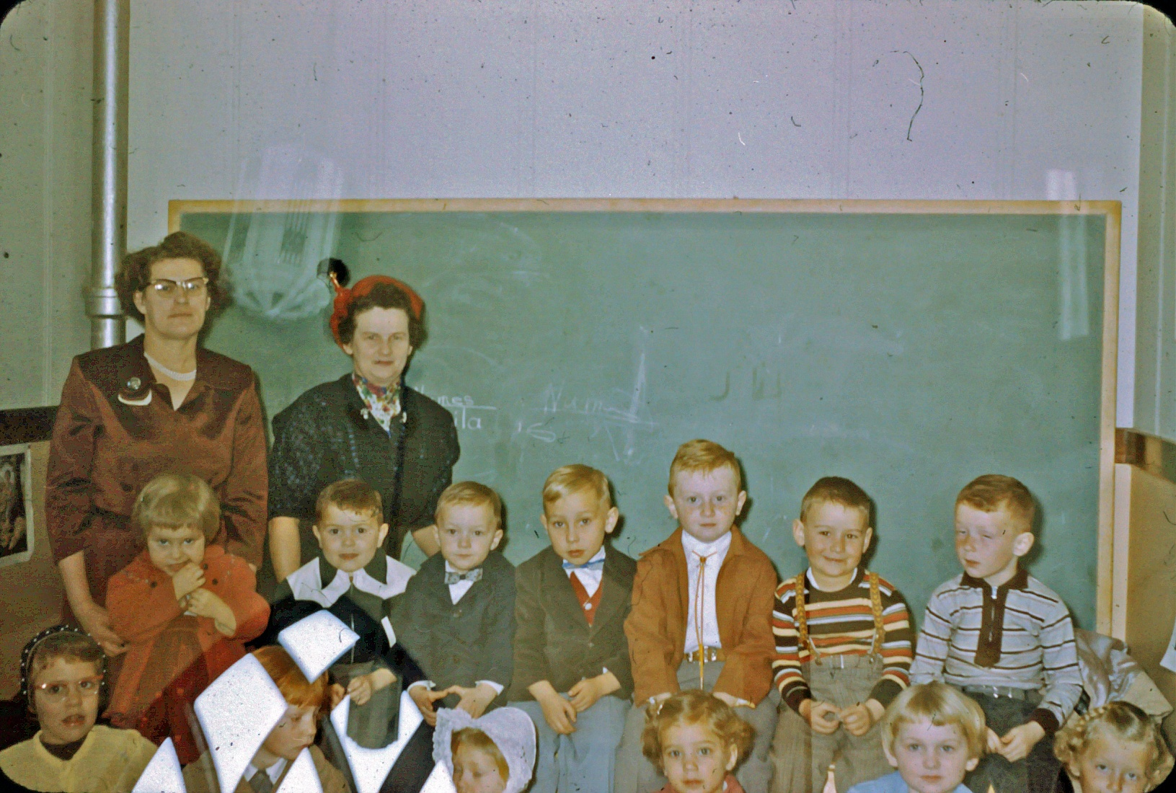
Teaching Sunday School

Slide 39
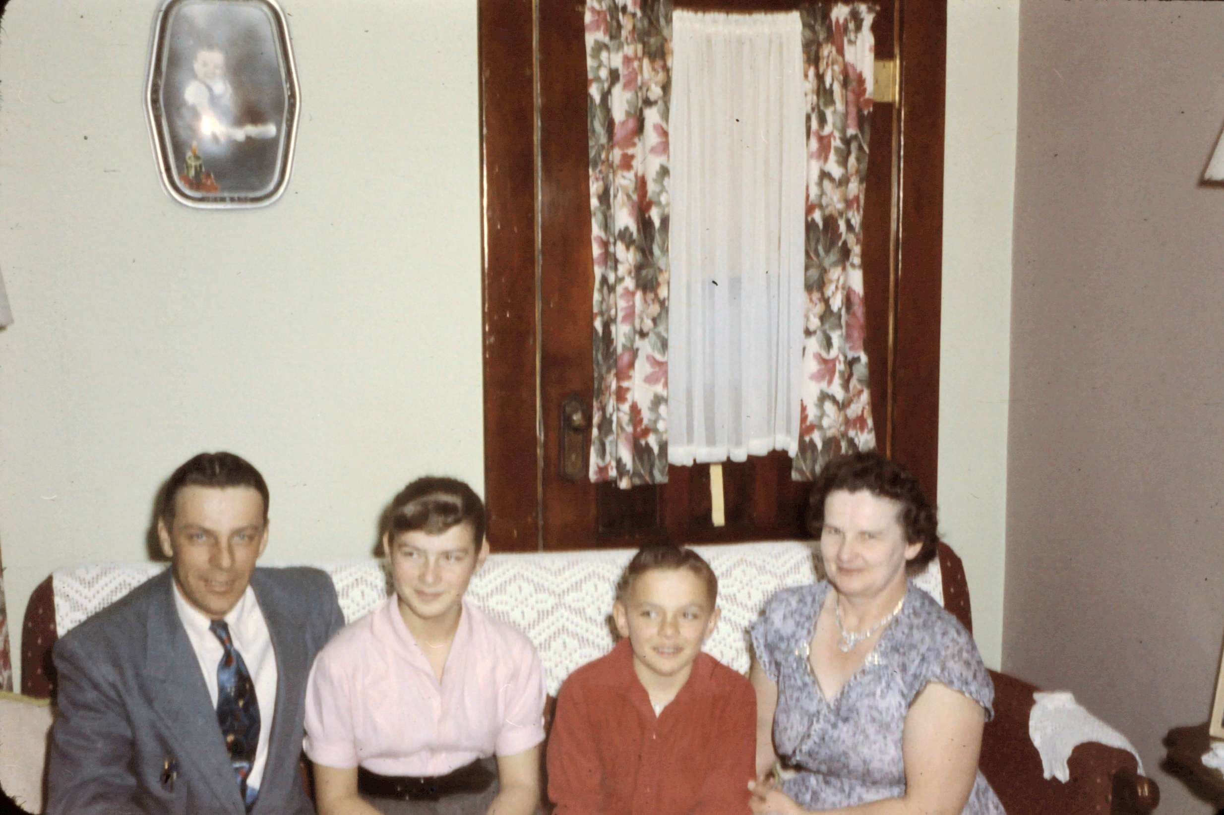

Slide 40
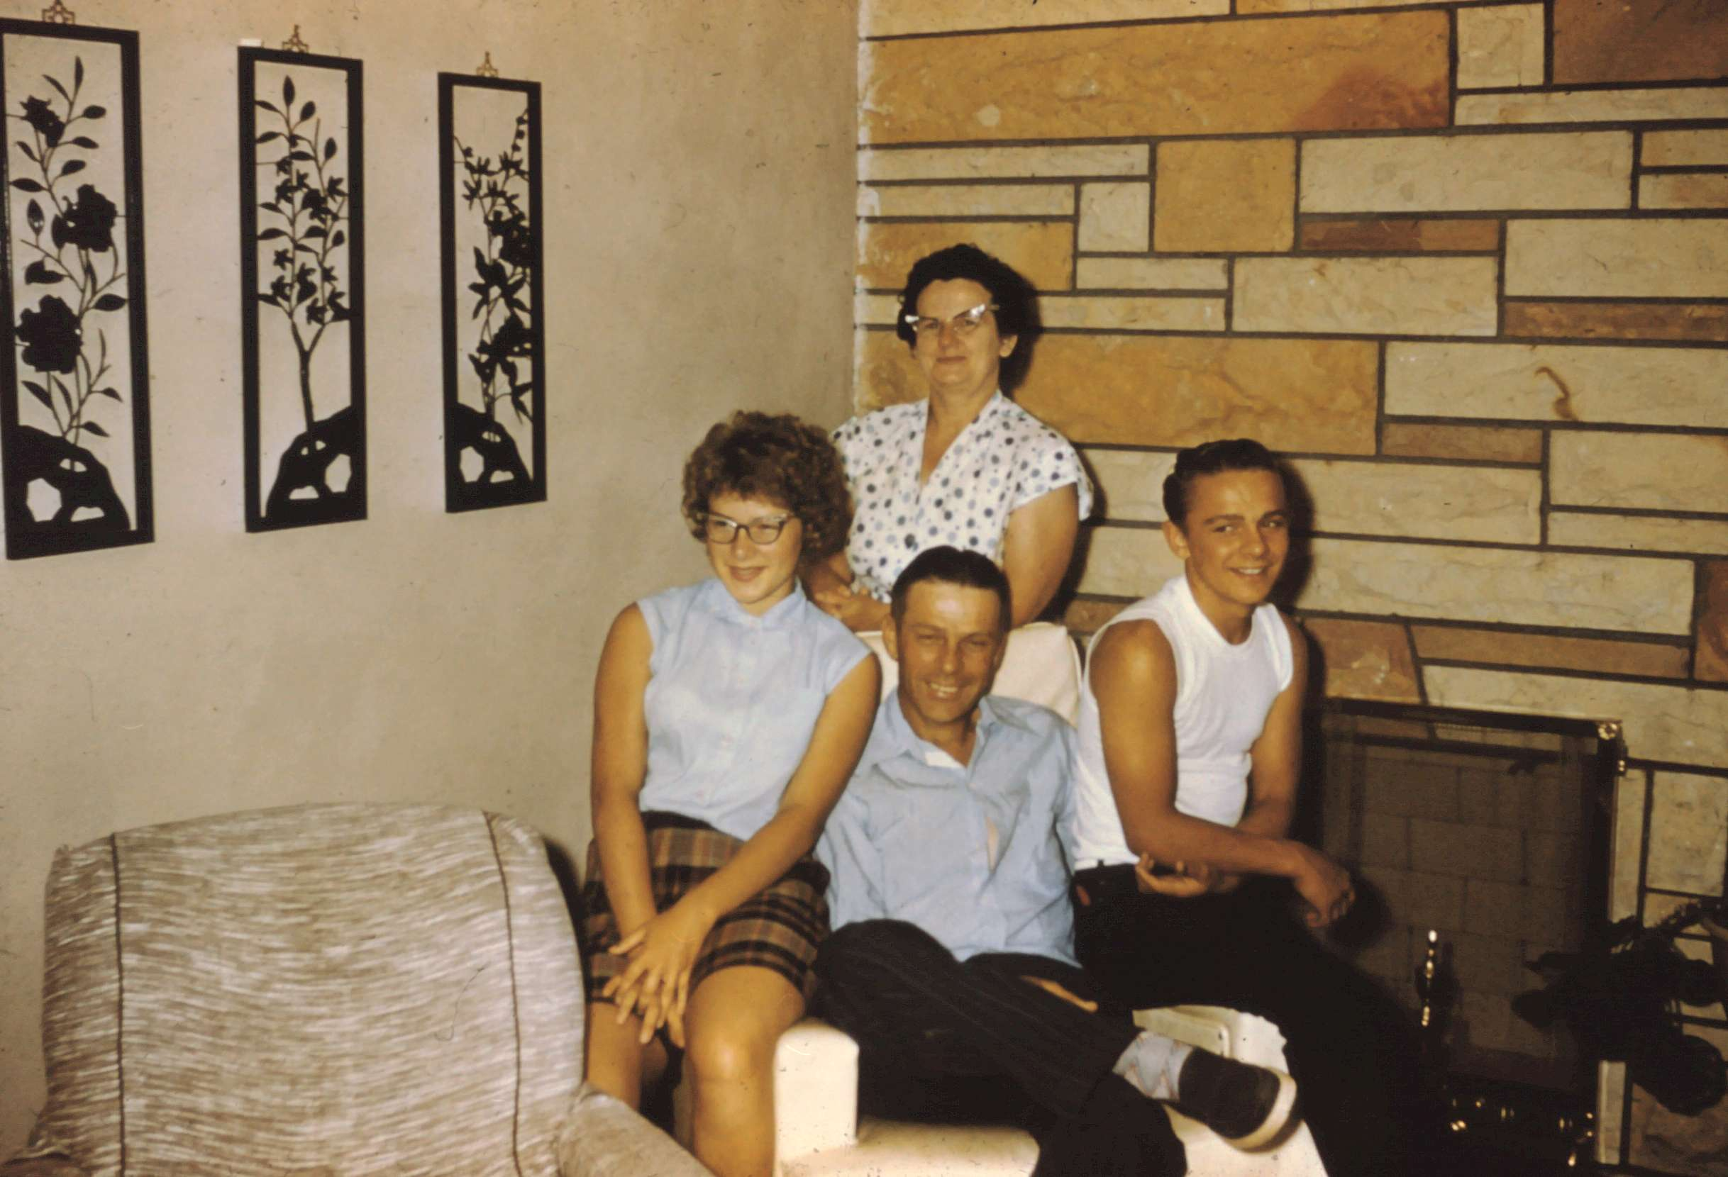

Slide 41
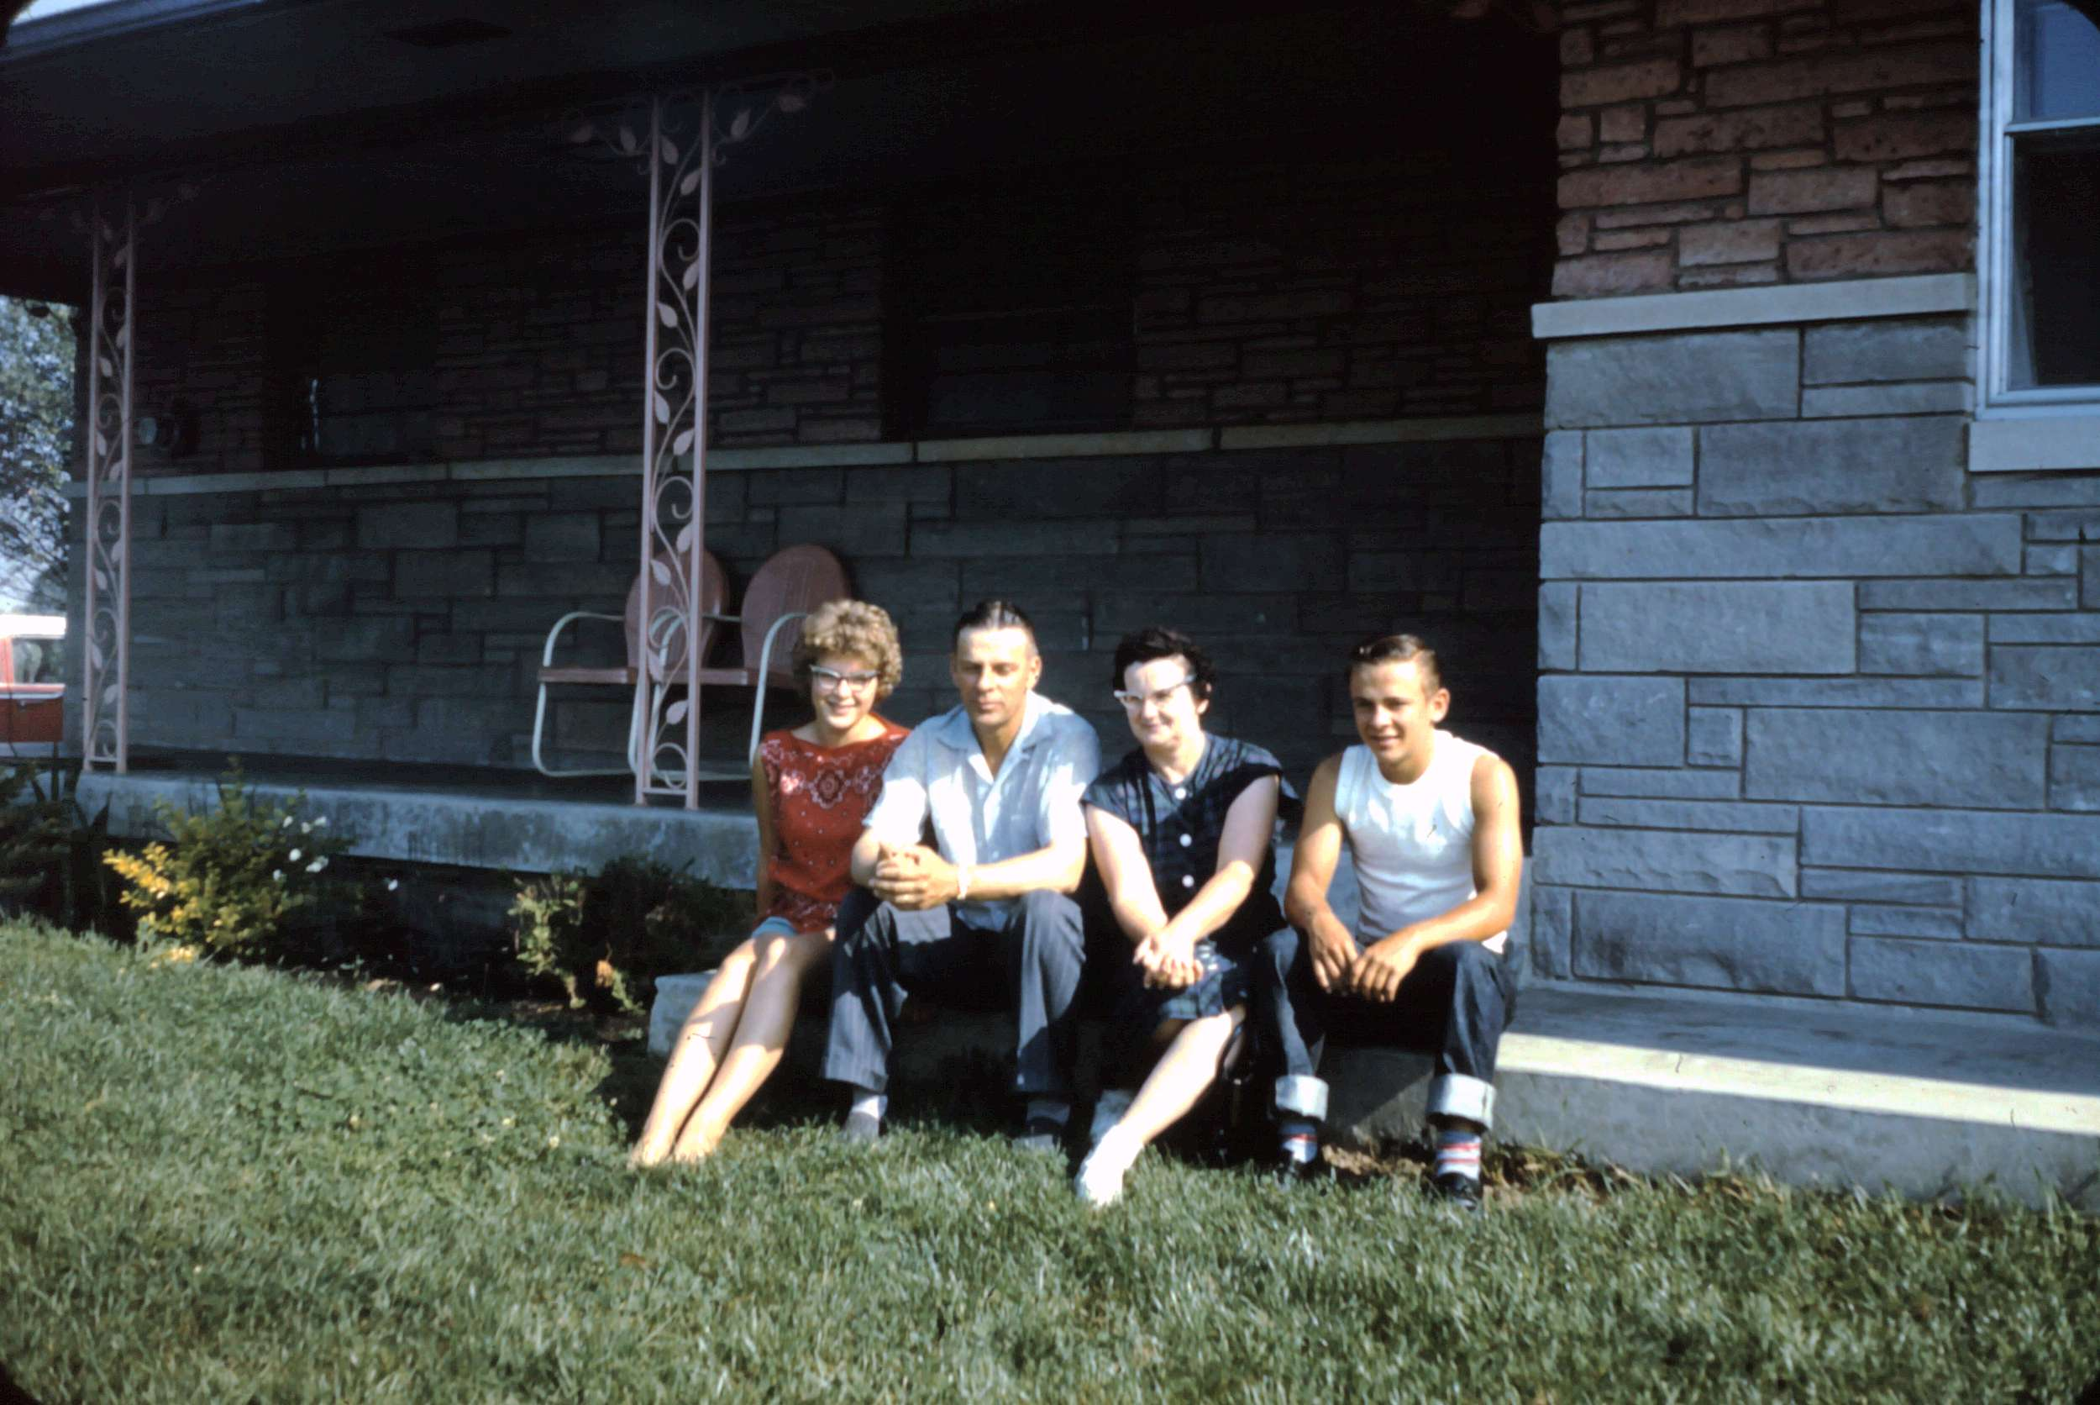

Slide 42
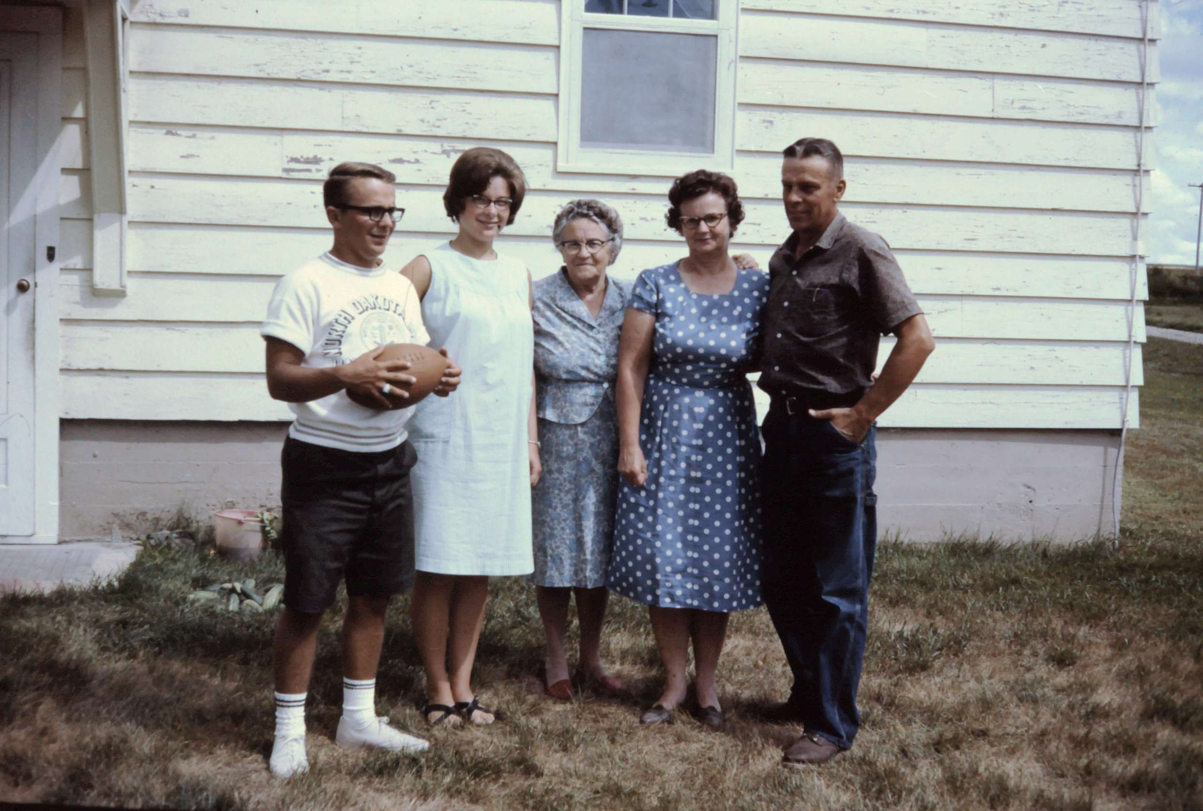
The Schlafmann family with Grandma Nelson

Slide 43
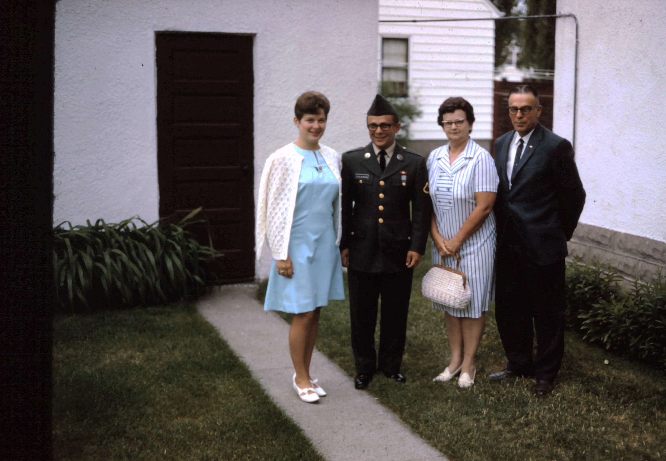

Slide 44
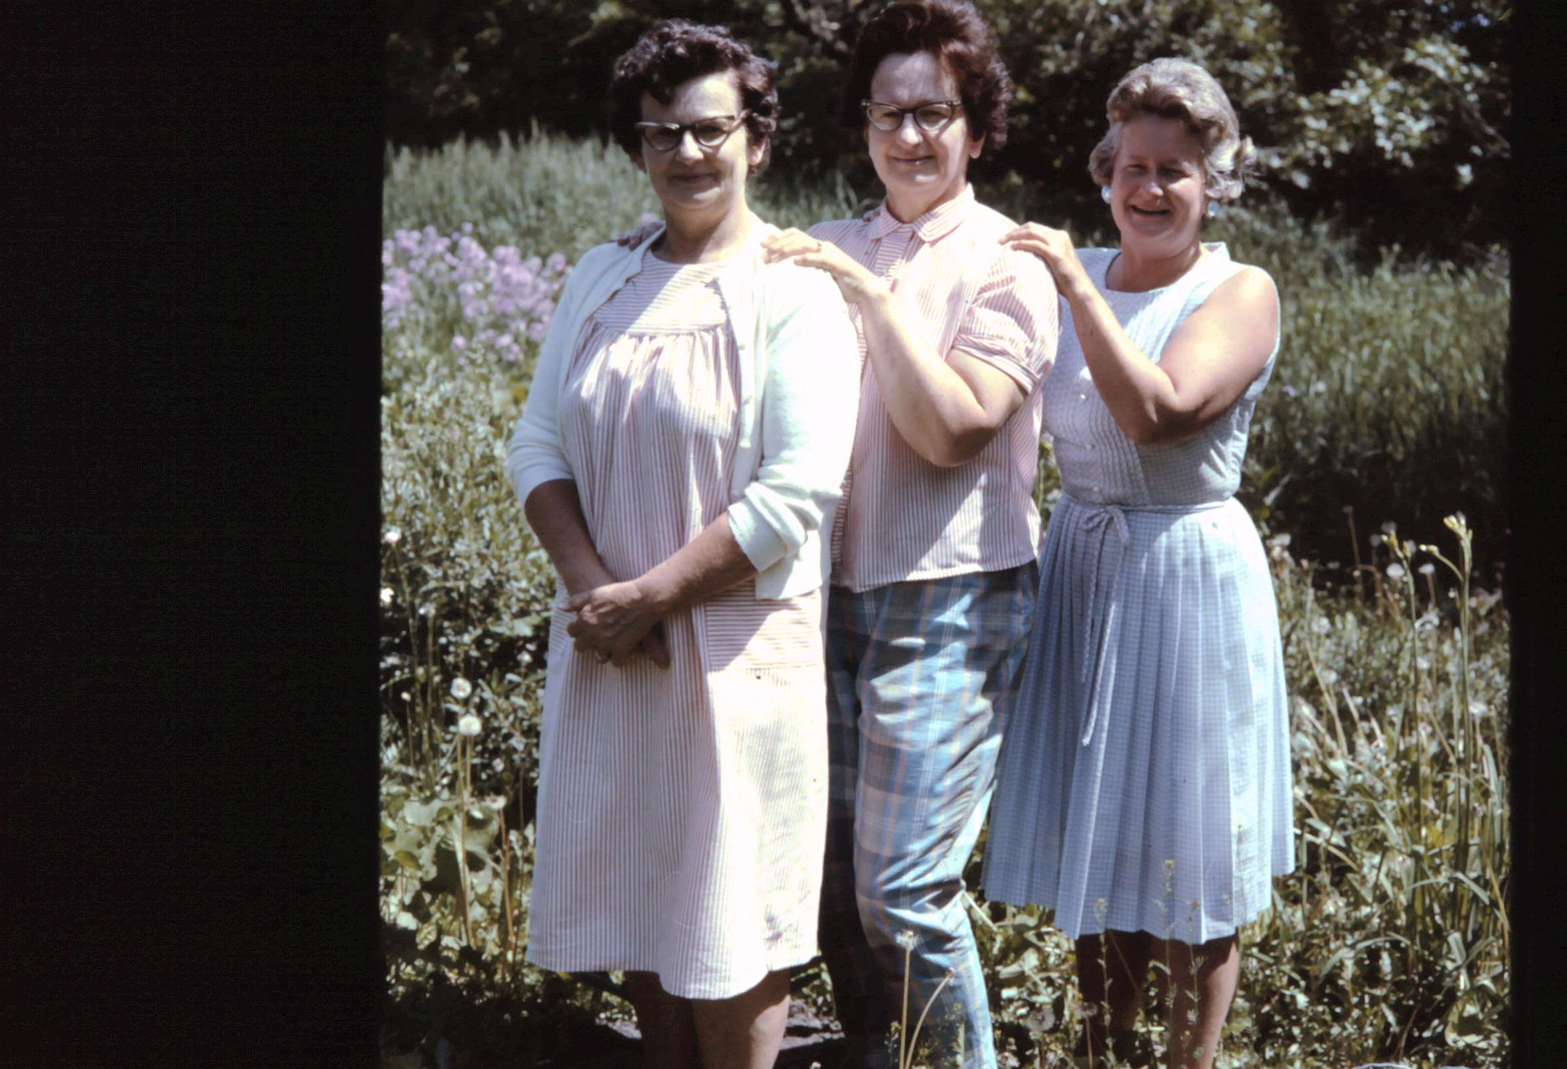
Three Nelson sisters

Slide 45
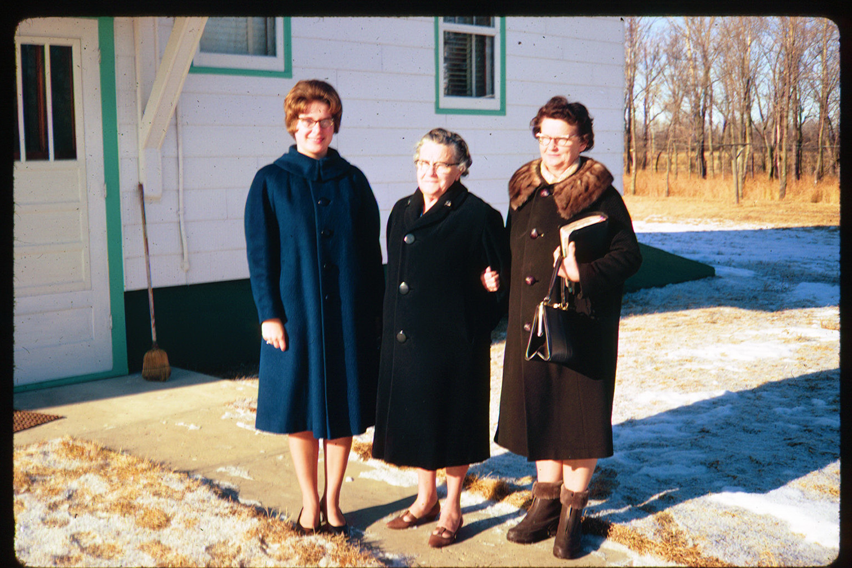
Three generations – Sharon, grandma Nelson, Elsie

Slide 46
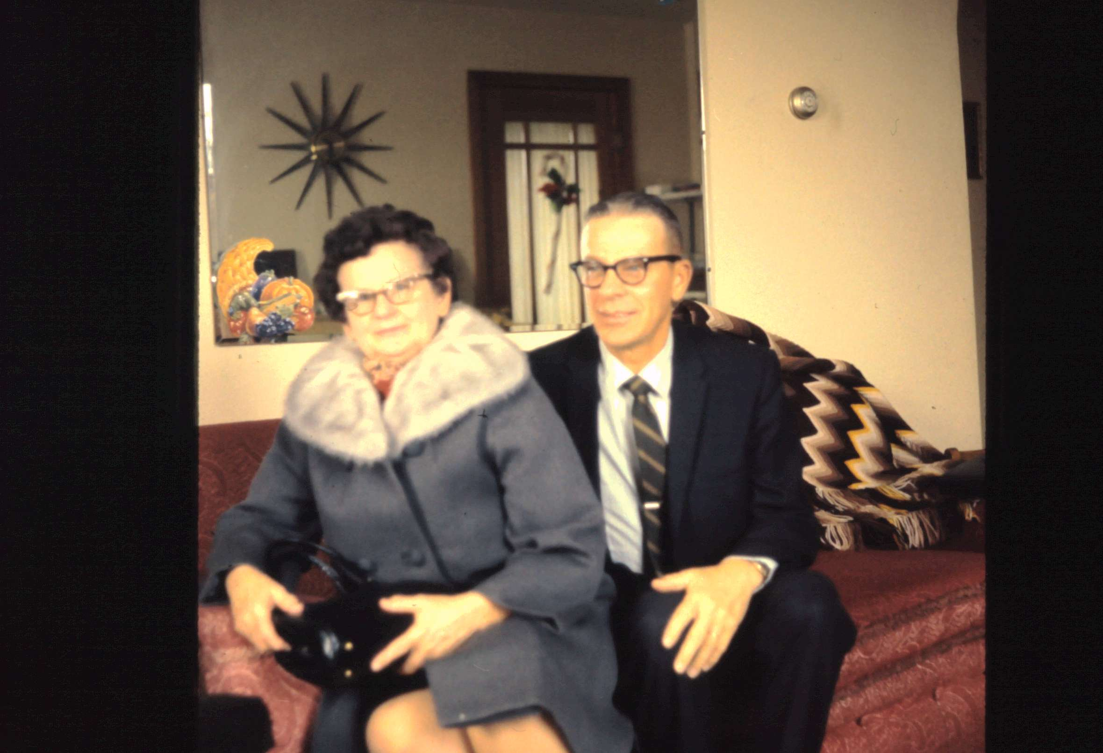

Slide 47
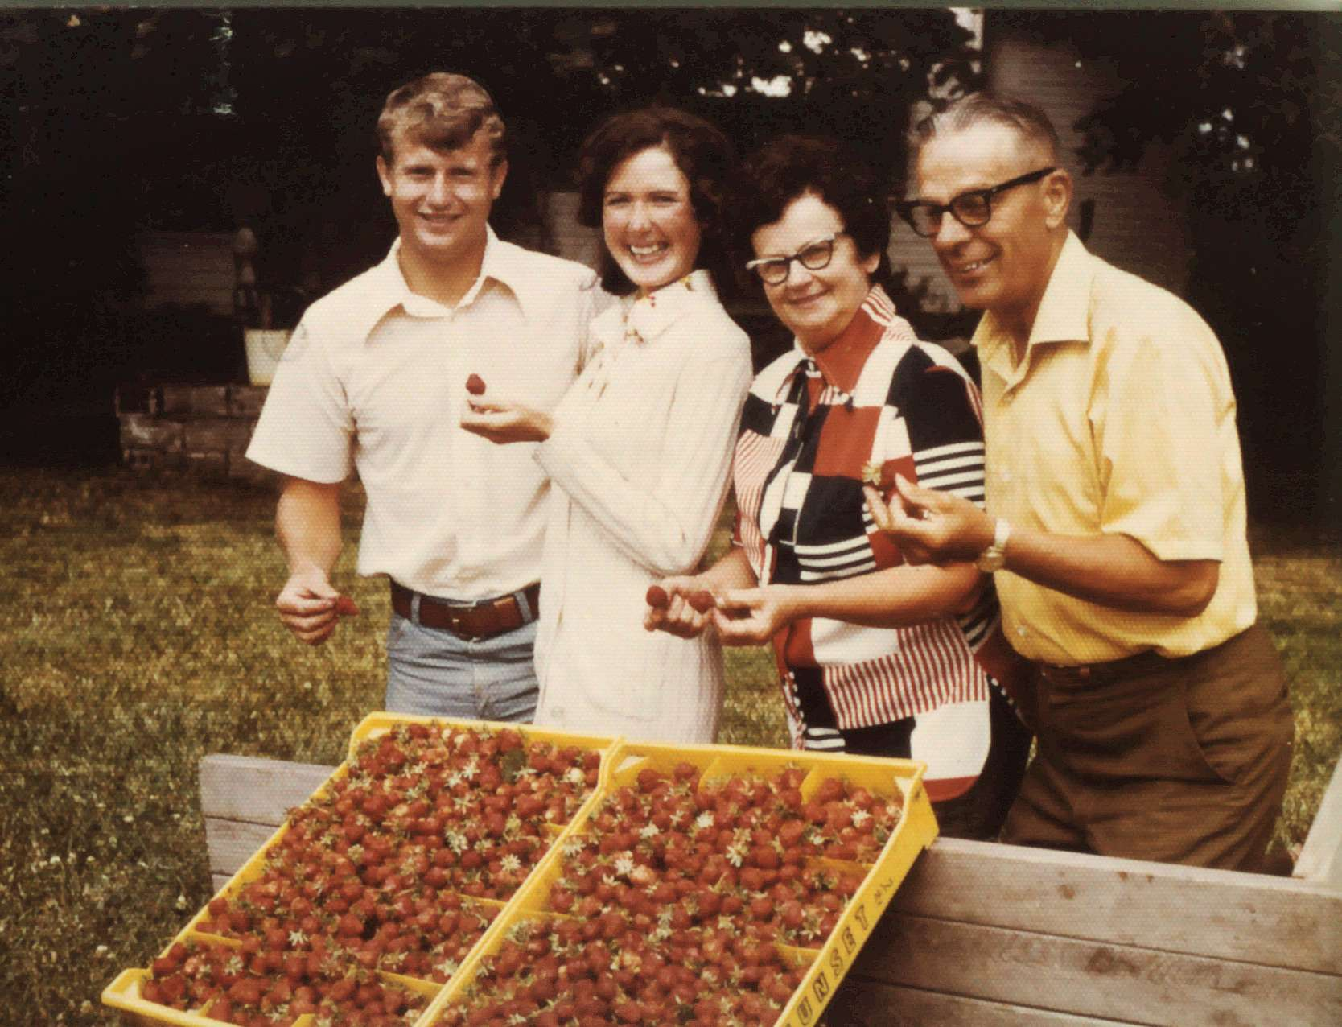
Strawberry picking with Mark & Jenny

Slide 48
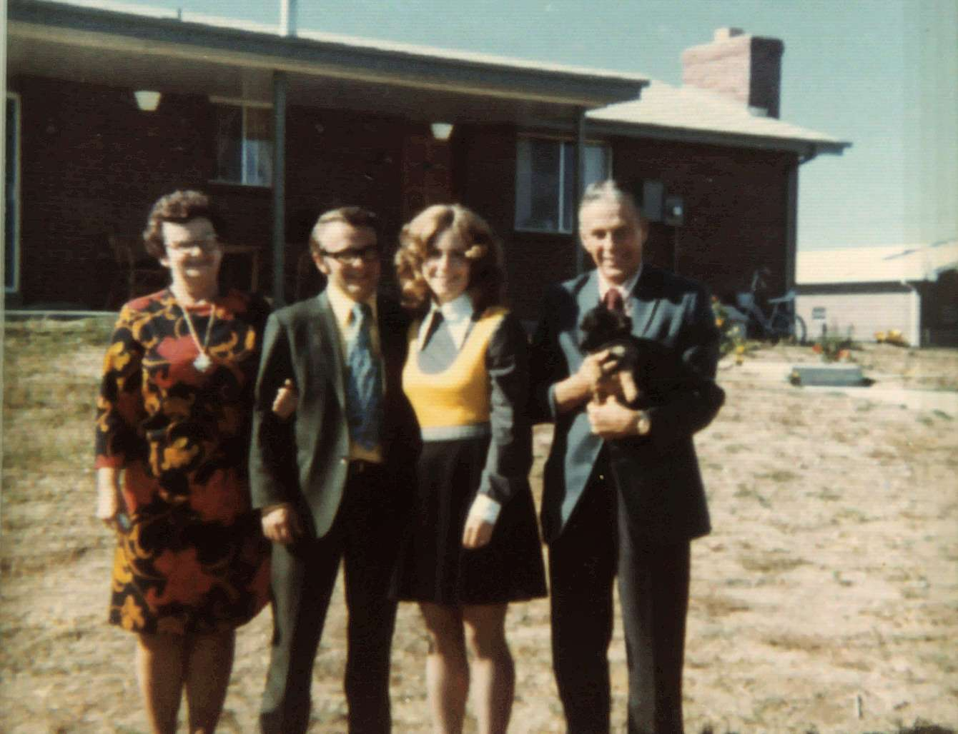
Elsie, Jarvis, Marilyn, Jake

Slide 49
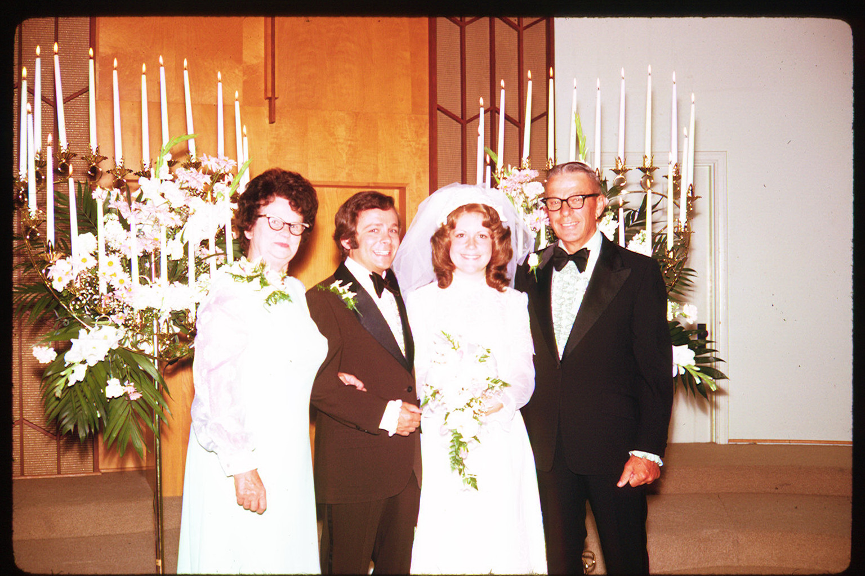

Slide 50
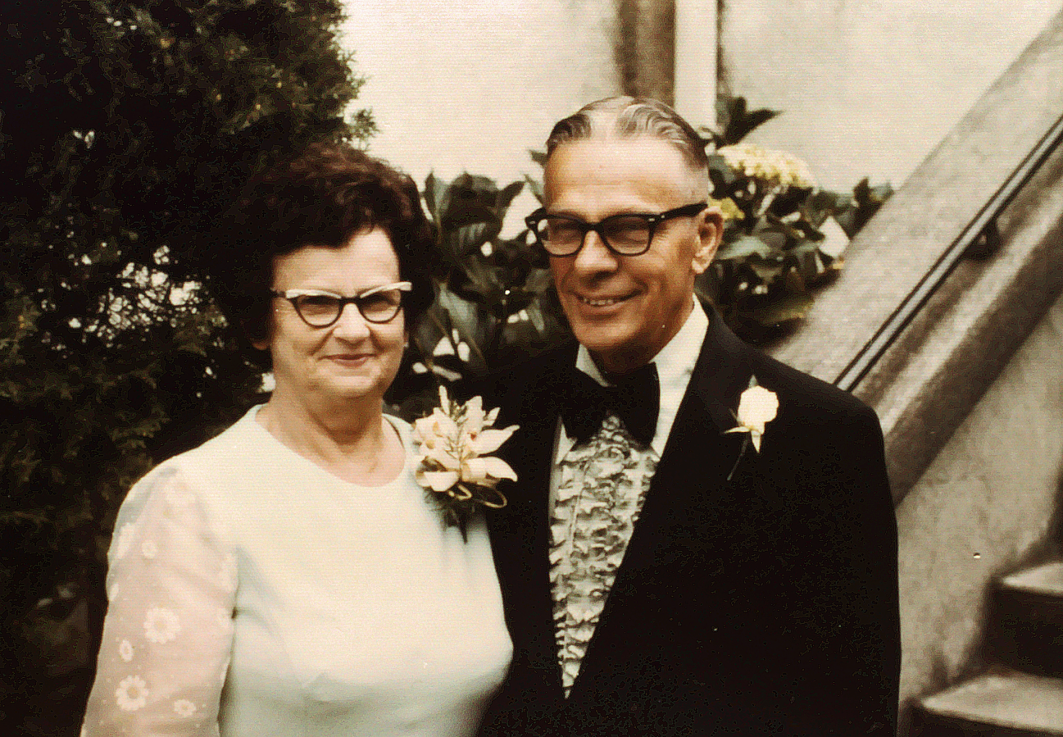
Jake & Elsie at Jarvis & Marilyn’s wedding

Slide 51
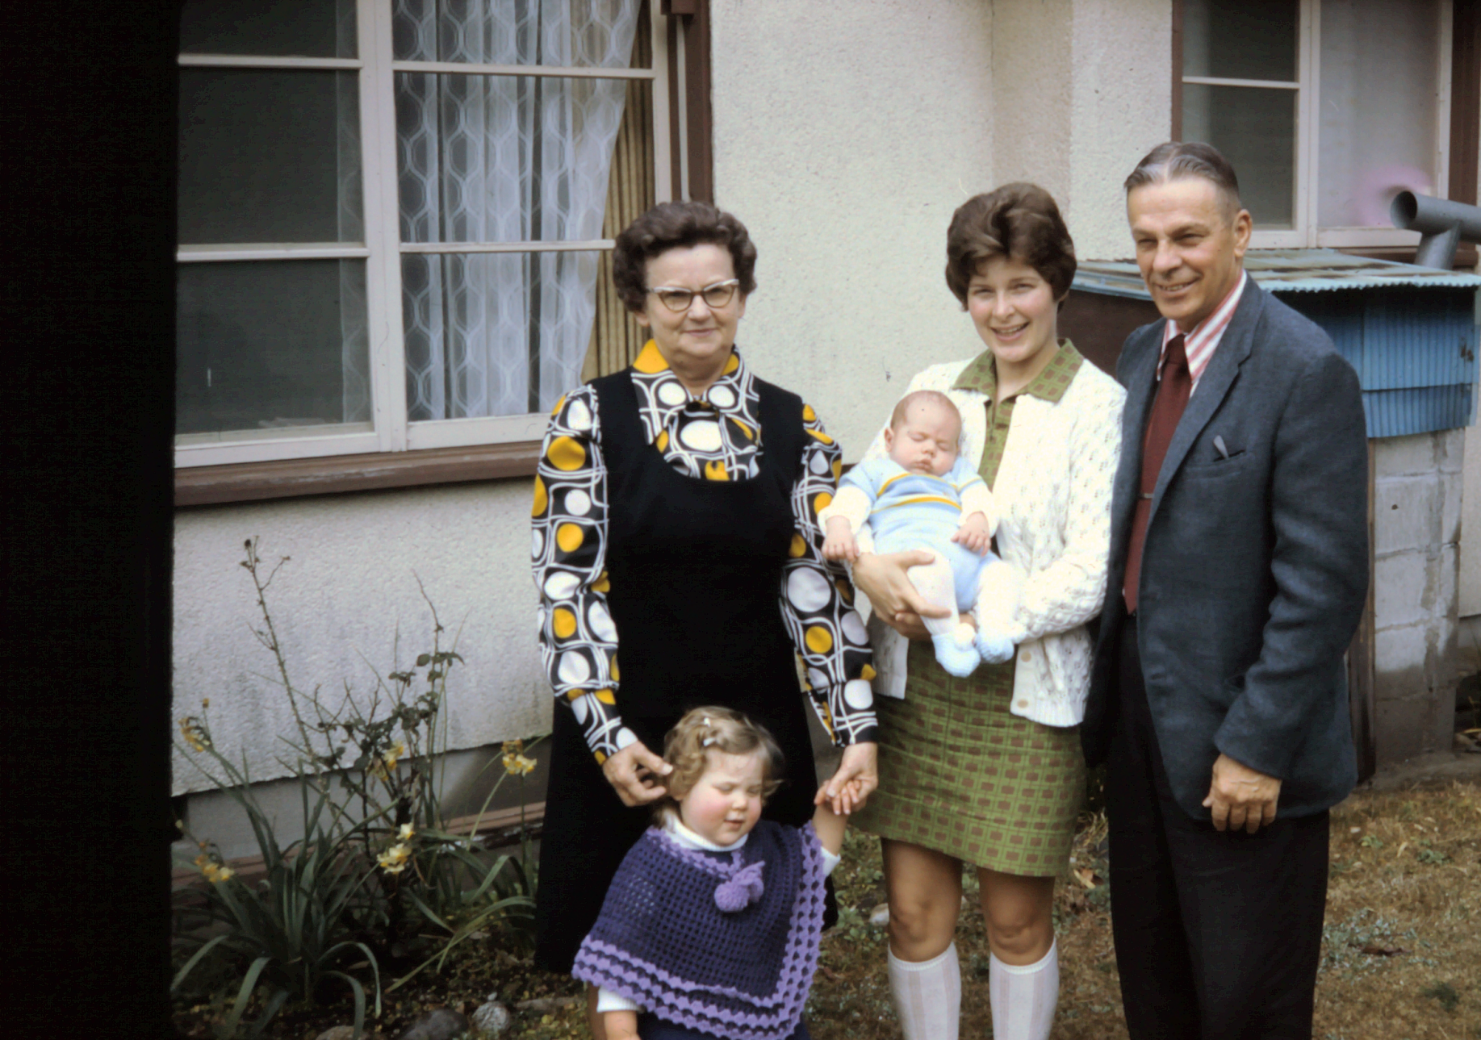
Elsie, Joyce, Sharon, Todd, Jake

Slide 54
Jake & Elsie in Cameroon, West Africa with granddaughter Melody

Slide 55
Jake & Elsie with the grandkids - 1980

Slide 56
Celebrating 40 years of marriage with the family

Slide 60
The house on Eggert St. Turtle Lake

Slide 62
Doug & Sharon, Jake & Elsie, Jarvis & Marilyn

Slide 65
Jake & Elsie at the wedding of Melody & Eric Swanson

Slide 78
The great grandchildren – Turtle Days Parade

Slide 79
Happy 100th Birthday Elsie!

Slide 82
Elsie, Jarvis, Joe Satrom

Slide 83
Royce, Joyce, Irv, Audrey & Elsie

Slide 84
Elsie turns 101 – with Sharon & Doug

Slide 86
Jason, Luke, Elsie

